Slide 1
Review and AI Agent Design III: Evaluation

Slide 2
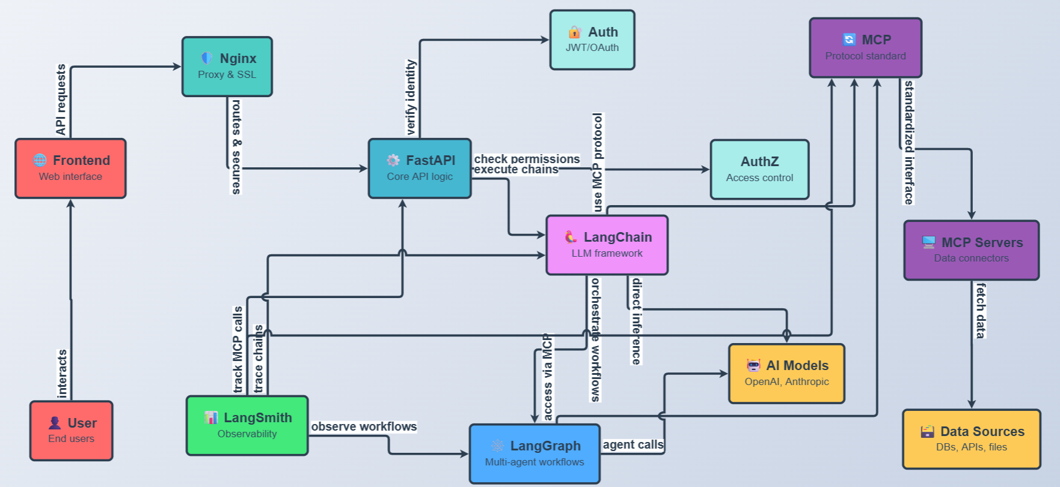
Chatbot UI
1. Most LLM API endpoint for

Slide 3
Chatbot UI
1. Most LLM API endpoint for

Slide 4
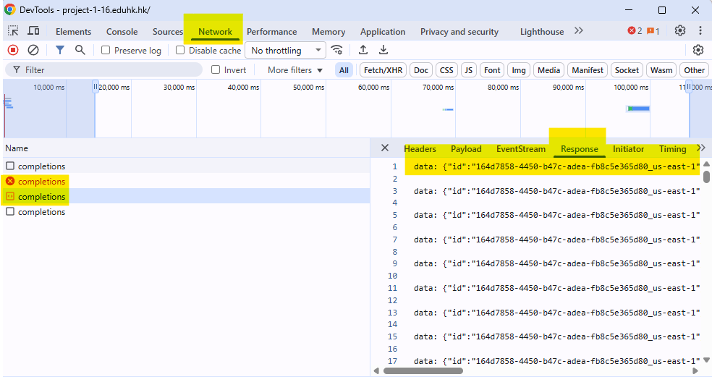
Chatbot UI
API endpoint is stateless
You need to sent full chat history to API endpoint
You can find the response format in the network tab

Slide 5
Why do you need to get the complete response format?
The to collect enough information for AI to program for you
Name | Description | URL
Base44 | AI platform for building full-stack apps from prompts with auto-deployment. Free starter plan. | https://base44.ai/
Bolt.new | Browser-based AI for generating and deploying full-stack apps. Free tier for personal projects. | https://bolt.new/
Cline | Local-first AI coding agent for VS Code with task planning. Free open-source plan. | https://cline.app/
Windsurf | AI-native IDE with agentic editing and multi-model support. Free tier for individuals. | https://windsurf.com/
Cursor | AI-first code editor for generation and refactoring. Free tier with limited AI usage. | https://cursor.sh/
GitHub Copilot | AI for real-time code suggestions and PR reviews in IDEs. Free for individuals and OSS. | https://github.com/features/copilot
Replit | An AI-powered platform for building professional web apps and websites. | https://replit.com/

Slide 6
Chatbot UI vibe coding keywords
Single page html (for fast prototyping)
React (with Vite: Vite is a modern frontend build tool)

Slide 7
Why Vite?
Fast Development Experience
Strong Ecosystem and Community Backing
Simplicity and Extensibility
ES Modules Facilitate UI Modularization

Slide 8
ES Modules Facilitate UI Modularization
Break down UI rendering designs into separate files
Frameworks like React, Vue, or vanilla JS
Performance Benefits: Modules enable code-splitting
(lazy-loading parts of the UI) and removing unused code,
which is crucial for fast-loading UIs.

Slide 10
Nginx
Serve static Front-End application
Reverse proxy to different web resource

Slide 11
Reverse proxy to different web resource
Forces everyone to use secure connections (HTTPS)
Routes different types of requests to different applications running on the server
Ensures secure, encrypted communication

Slide 12
Nginx
server {
listen 80;
server_name project-1-04.eduhk.hk;
return 301 https://$host$request_uri;
}
listen 80: Port 80 is the standard "door" for regular HTTP traffic (non-secure). This tells Nginx to watch this door.
server_name project-1-04.eduhk.hk: This says "I handle requests for project-1-04.eduhk.hk"

Slide 13
Nginx(return)
server {
listen 80;
server_name project-1-04.eduhk.hk;
return 301 https://$host$request_uri;
}
return 301 https://$host$request_uri:
What it does: This is a Nginx directive that immediately stops processing and sends a response back to the browser.
How it works:
When Nginx encounters return, it doesn't look at any other configuration below it
It immediately constructs and sends the response
No further processing happens for this request
Think of it like: A receptionist who says "Sorry, you need to go to a different building" and gives you the new address, instead of processing your request at the current location.

Slide 14
Nginx(301)
server {
listen 80;
server_name project-1-04.eduhk.hk;
return 301 https://$host$request_uri;
}
return 301 https://$host$request_uri:
What it is: An HTTP status code meaning "Moved Permanently“
HTTP Status Codes - Quick Overview:
2xx = Success (200 = OK)
3xx = Redirection (301 = Moved Permanently, 302 = Moved Temporarily)
4xx = Client Error (404 = Not Found)
5xx = Server Error (500 = Internal Server Error)

Slide 15
Nginx(301)
server {
listen 80;
server_name example.com www.example.com;
return 301 https://$host$request_uri;
}
return 301 https://$host$request_uri:
For HTTPS redirects, 301 is used because:
You always want HTTPS, forever
You want browsers to remember this
You want search engines to index the HTTPS version

Slide 16
Nginx(https://)
server {
listen 80;
server_name project-1-04.eduhk.hk;
return 301 https://$host$request_uri;
}
return 301 https://$host$request_uri:
What it is: The protocol/scheme for the new URL
This specifies:
Use the HTTPS protocol (secure, encrypted)
Browser should connect on port 443 (HTTPS default port)
An encrypted TLS/SSL connection must be established
The redirect changes only the protocol, not the domain or path.

Slide 17
Nginx($host)
server {
listen 80;
server_name project-1-04.eduhk.hk;
return 301 https://$host$request_uri;
}
What it is: A Nginx variable containing the hostname from the request
How it works: When a browser makes a request, it includes a "Host" header. Nginx captures this in the $host variable.
Does anyone know what a header is?

Slide 18
Nginx($host)
server {
listen 80;
server_name project-1-04.eduhk.hk;
return 301 https://$host$request_uri;
}
Benefit: Preserves whatever domain the user typed
www.project-1-04.eduhk.hk → https://www.project-1-04.eduhk.hk
project-1-04.eduhk.hk → https://project-1-04.eduhk.hk

Slide 19
Nginx($request_url)
server {
listen 80;
server_name project-1-04.eduhk.hk;
return 301 https://$host$request_uri;
}
What it is: A Nginx variable containing the complete original request path and query string
What it includes:
The path (everything after the domain)
Query parameters (the ? and everything after it)
Fragment identifiers are NOT included (the # part - browsers don't send this to servers)

Slide 20
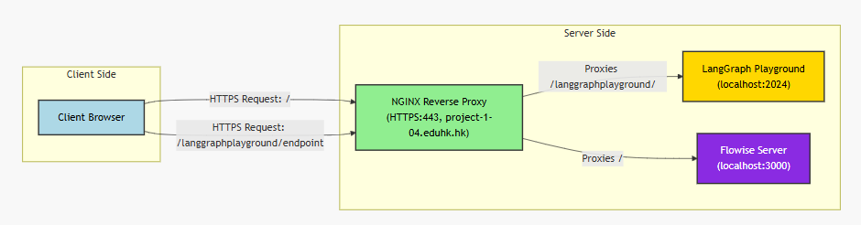
Nginx($request_url)

Slide 21
Nginx(location /langgraphplayground/)
location /langgraphplayground/
What it matches: Any URL starting with /langgraphplayground/
Examples:
✓ https://project-1-04.eduhk.hk/langgraphplayground/
✓ https://project-1-04.eduhk.hk/langgraphplayground/api/chat
✓ https://project-1-04.eduhk.hk/langgraphplayground/static/logo.png
✗ https://project-1-04.eduhk.hk/langGraph/ (case-sensitive)
✗ https://project-1-04.eduhk.hk/other/path

Slide 22
Nginx(location /langgraphplayground/)
The trailing slash matters:
location /langgraphplayground/ { # With trailing slash
# Matches: /langgraphplayground/*, but NOT /langgraphplayground
}
location /langgraphplayground { # Without trailing slash
# Matches: /langgraphplayground and /langgraphplayground/*
}
In your case, with the trailing slash:
/langgraphplayground → Goes to location / (caught by second block)
/langgraphplayground/ → Goes to this block ✓
/langgraphplayground/chat → Goes to this block ✓

Slide 23
Nginx(SSE Requirements)
location /langgraphplayground/ {
proxy_pass http://localhost:2024;
proxy_http_version 1.1; # ✓ HTTP/1.1 (good for SSE)
proxy_buffering off; # ✓ if you want streams immediately
proxy_cache off; # ✓ No caching
proxy_read_timeout 300s; # ✓ Long timeout for persistent connection
# ... other headers
}
For SSE to work properly, you need:
- HTTP/1.1 (technically works with 1.0, but 1.1 is better)
- No response buffering (if you want streams immediately)
- Long read timeout (SSE connections stay open)
- No caching (each event stream is unique)

Slide 24
Nginx (if you want streaming)
location / {
proxy_pass http://localhost:3000;
# CRITICAL for Flowise streaming
proxy_http_version 1.1; # ← ADD THIS
proxy_set_header Connection ""; # ← ADD THIS
proxy_buffering off; # ← ADD THIS
proxy_cache off; # ← ADD THIS
proxy_read_timeout 300s; # ← ADD THIS (AI can take time)
# Standard headers
proxy_set_header Host $host;
proxy_set_header X-Real-IP $remote_addr;
proxy_set_header X-Forwarded-For $proxy_add_x_forwarded_for;
proxy_set_header X-Forwarded-Proto $scheme;
}
sudo nginx –t
sudo systemctl reload nginx

Slide 26
FastAPI and LangChain and LangGraph
LangChain as the Foundation
Handles core LLM logic, such as chaining prompts, managing memory (e.g., conversation history), and integrating external tools/data sources. It's the "brain" for simple interactions.
LangGraph as the Orchestrator
Builds on LangChain to create dynamic, graph-based workflows. In chatbots, it manages multi-turn conversations, agentic behaviors (e.g., deciding when to call tools or end a loop), and state persistence across sessions.
FastAPI as the Interface
Serves as the entry point, turning the LangChain/LangGraph logic into a web service. It handles routing, request validation, and response streaming, making the chatbot accessible via APIs for frontends or integrations and serving the frontend.

Slide 27
The relationship between LangGraph and LangChain and FastAPI
from typing import Annotated, Sequence
from fastapi import FastAPI, Request
from fastapi.responses import HTMLResponse
from fastapi.staticfiles import StaticFiles
from pydantic import BaseModel
from langchain_core.messages import BaseMessage, SystemMessage, HumanMessage, ToolMessage
from langgraph.graph.message import add_messages
from langgraph.graph import StateGraph, END
from langchain_core.tools import tool
from langchain_aws import ChatBedrock
from langgraph.checkpoint.memory import MemorySaver
import json

Slide 28
What is Sequence? Like [“1”, “2”, “3”]
from typing import Sequence
# ❌ Too restrictive - only accepts lists
def process_items(items: list[str]) -> int:
return len(items)
# ✅ Better - accepts any sequence type
def process_items(items: Sequence[str]) -> int:
return len(items)
# Now all of these work:
process_items(["a", "b", "c"]) # list ✓
process_items(("a", "b", "c")) # tuple ✓
process_items({"a", "b", "c"}) # ✗ set is NOT a sequence (unordered)

Slide 29
What is Annotated? For documentation
from typing import Annotated
def send_email(
recipient: Annotated[str, "Email address of the recipient"],
subject: Annotated[str, "Email subject line, max 100 chars"],
body: Annotated[str, "HTML or plain text email body"]
) -> None:
...

Slide 30
What is FastAPI?
from fastapi import FastAPI
app = FastAPI(
title="My API", # API name (shows in docs)
description="A cool API", # API description
version="1.0.0", # API version
)

Slide 31
What is FastAPI?
from fastapi import FastAPI, Request
from fastapi.responses import HTMLResponse
from fastapi.staticfiles import StaticFiles
Request
1. Purpose: Represents HTTP request data
2. Use Case: Access request headers, body, query parameters, etc.
HTMLResponse
1. Purpose: Returns HTML content in HTTP responses
2. Use Case: Serve web pages directly from FastAPI
StaticFiles
1. Purpose: Serves static files (CSS, JavaScript, images)
2. Use Case: Mount static file directories to the application

Slide 32
What is Pydantic?
What is Pydantic?
Purpose: Data validation and settings management using Python type annotations
BaseModel: Base class for creating data models with automatic validation
Use in LangGraph
from pydantic import BaseModel
class ChatRequest(BaseModel):
message: str
thread_id: str

Slide 33
The relationship between LangGraph and LangChain and FastAPI: FastAPI code
# Serving Static files
app = FastAPI()
app.mount("/static", StaticFiles(directory="static", html=True), name="static")
# LangChain and LangGraph logic starts
#...
# LangChain and LangGraph logic ends
# Frontend calling these endpoints
@app.get("/", response_class=HTMLResponse)
async def root(request: Request):
return HTMLResponse(open("static/index.html").read())
@app.post("/chat")
async def chat(input: ChatInput):
config = {"configurable": {"thread_id": input.thread_id}}
state = {"messages": [HumanMessage(content=input.message)]}
result = graph.invoke(state, config)
return {"response": result["messages"][-1].content}

Slide 34
The relationship between LangGraph and LangChain and FastAPI: LangChain code
# LLM: AWS Nova Lite via Bedrock
llm = ChatBedrock(model_id="amazon.nova-lite-v1:0", region_name="us-east-1")
# Simple tool
@tool
def multiply(a: int, b: int) -> int:
"""Multiply two numbers."""
return a * b
tools = [multiply]
llm = llm.bind_tools(tools)
tools_by_name = {tool.name: tool for tool in tools}

Slide 35
The relationship between LangGraph and LangChain and FastAPI: LangGraph code
# State
class AgentState(dict):
messages: Annotated[Sequence[BaseMessage], add_messages]
# Nodes
def tool_node(state: AgentState):
outputs = []
for tool_call in state["messages"][-1].tool_calls:
tool_result = tools_by_name[tool_call["name"]].invoke(tool_call["args"])
outputs.append(ToolMessage(content=json.dumps(tool_result), name=tool_call["name"], tool_call_id=tool_call["id"]))
return {"messages": outputs}
def call_model(state: AgentState):
system_prompt = SystemMessage("You are a helpful AI. Use tools if needed.")
response = llm.invoke([system_prompt] + state["messages"])
return {"messages": [response]}

Slide 36
The relationship between LangGraph and LangChain and FastAPI: LangGraph code
# Condition
def should_continue(state: AgentState):
last_message = state["messages"][-1]
if not last_message.tool_calls:
return "end"
return "continue"
# Graph
workflow = StateGraph(state_schema=AgentState)
workflow.add_node("agent", call_model)
workflow.add_node("tools", tool_node)
workflow.set_entry_point("agent")
workflow.add_conditional_edges("agent", should_continue, {"continue": "tools", "end": END})
workflow.add_edge("tools", "agent")
memory = MemorySaver()
graph = workflow.compile(checkpointer=memory)
class ChatInput(BaseModel):
message: str
thread_id: str = "1" # Default for simplicity

Slide 37
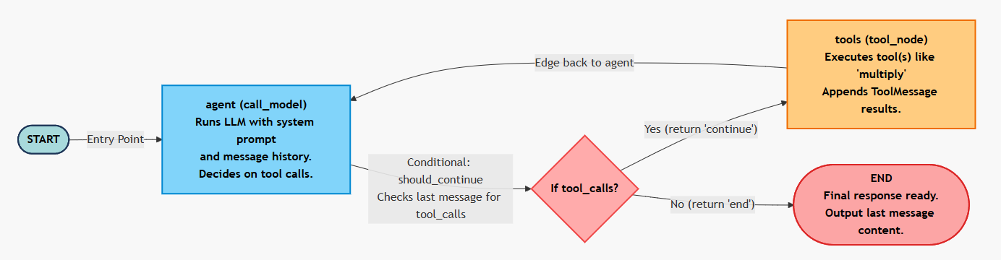
The relationship between LangGraph and LangChain and FastAPI: LangGraph code
LangGraph
LangChain
LangChain

Slide 38
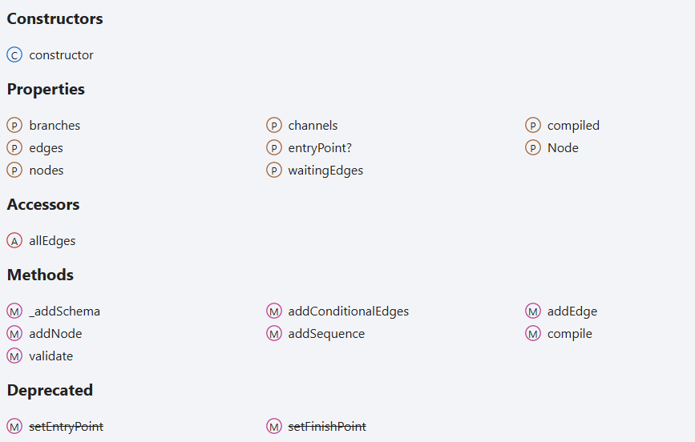
The relationship between LangGraph and LangChain and FastAPI: LangGraph
https://langchain-ai.github.io/langgraphjs/reference/classes/langgraph.StateGraph.html

Slide 39
Frontend
<!DOCTYPE html>
<html><body>
<div id="messages"></div>
<input id="input" placeholder="Type message"><button onclick="send()">Send</button>
<script>
const threadId = crypto.randomUUID(); // Unique per instance
async function send() {
const inp = document.getElementById('input');
const msg = inp.value; inp.value = '';
document.getElementById('messages').innerHTML += `<p>You: ${msg}</p>`;
const res = await fetch('/chat', {method: 'POST', headers: {'Content-Type': 'application/json'}, body: JSON.stringify({message: msg, thread_id: threadId})});
const data = await res.json();
document.getElementById('messages').innerHTML += `<p>Bot: ${data.response}</p>`;
}
</script>
</body></html>

Slide 40
config = {"configurable": {"thread_id": input.thread_id}}
The config dict passes the actual thread_id (from the request input) to LangGraph's checkpointer during graph.invoke().
This overrides the default and enables the MemorySaver to load/save state (including message history) specific to that thread_id, isolating conversations across different users or sessions.
const res = await fetch('/chat', {method: 'POST', headers: {'Content-Type': 'application/json'}, body: JSON.stringify({message: msg, thread_id: threadId})});

Slide 41
Why thread_id: str = "1" # Default for simplicity?
1) This is in the ChatInput Pydantic model for request validation.
2) It sets a default value of "1" for thread_id if the frontend doesn't provide one in the POST body.
This ensures the API doesn't fail on missing fields (e.g., for quick testing), while allowing overrides for unique sessions.
class ChatInput(BaseModel):
message: str
thread_id: str = "1" # Default for simplicity

Slide 42
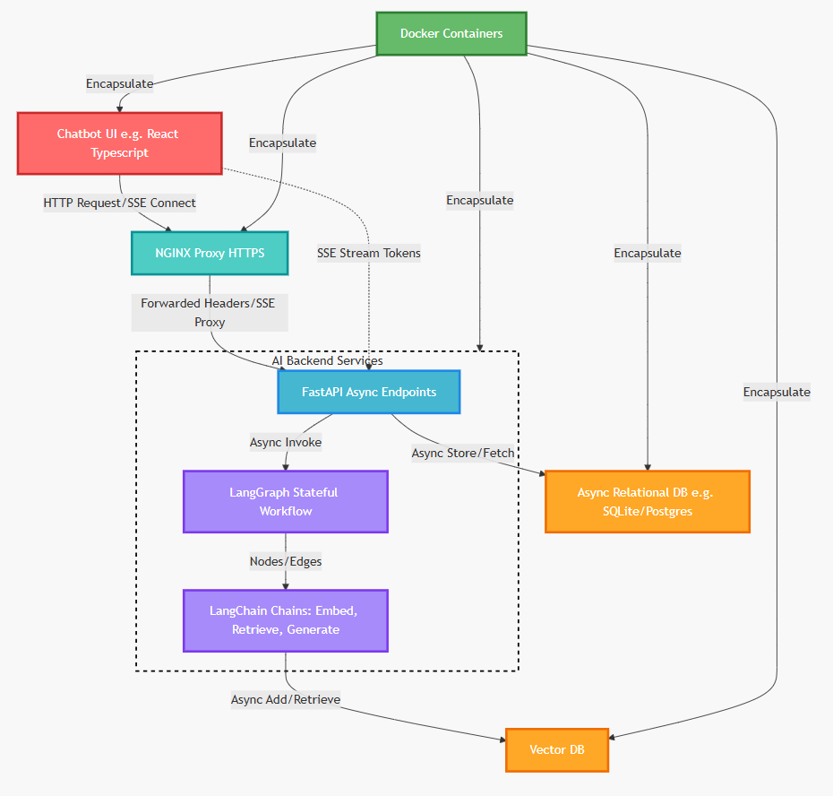
Why Docker?

Slide 43
Why Docker?
Consistency Across Environments:
Docker ensures that applications run the same way in development, testing, staging, and production.
Portability:
Containers can be easily moved and deployed across different machines, clouds, or operating systems without reconfiguration.
Isolation and Security:
Each container runs in its own isolated environment, preventing conflicts between applications (e.g., different versions of libraries).
Resource Efficiency:
Unlike virtual machines, Docker containers share the host OS kernel, making them lightweight and fast to start
Scalability and Speed:
Containers can be scaled up or down quickly, supporting microservices architectures.
Improved Development Productivity:
Developers can work in identical environments, simplifying collaboration and onboarding.

Slide 45
LangSmith & Evaluation Frameworks
A comprehensive guide to testing tools across LLM applications, AI agents, and web infrastructure
01
02
LangSmith Origins
Evaluation Ecosystems
From LangChain side project to enterprise platform
Core tool for LLM testing and agent tracing
03
04
Broader Frameworks
Integration Challenges
Domain-specific tools for diverse tech stacks
Custom setups for hybrid AI-web systems

Slide 46
LangSmith's Evolution
Late 2022
May 2025
Harrison Chase launches side project during ChatGPT boom
LangGraph expansion for stateful AI workflows
1
2
3
February 2024
Official SaaS launch for LLM monitoring and debugging
From open-source framework to commercial platform, addressing unpredictable outputs and scaling challenges in production environments.

Slide 47
LangSmith's Testing Role
Core Capabilities
2024
Real-time tracing for LLM applications
Automated evaluations with metrics
Launch Year
Human-in-the-loop feedback loops
Enterprise platform debut
Integration with LangGraph agents
Bridge for LLM-specific testing, supportive role in hybrid web-database setups.
78%
Incident Reduction
Via comprehensive testing

Slide 48










Framework Connections
AWS Bedrock
AI Agents
Secure API configurations
Simulation and metrics principles
NGINX
Performance benchmarks
MCP Inspectors
Targeted debugging insights
FastAPI
Async testing tools
Domain-specific tools create a diverse yet interconnected testing environment, with LangSmith aiding AI-enhanced evaluations.

Slide 49
Deep Dive
Exploring Each Framework
Detailed examination of evaluation tools across the AI and web infrastructure landscape

Slide 50
LangSmith: Enterprise LLM Platform
Origins
Core Features
Integration
Late 2022 side project → February 2024 SaaS launch
Observability, monitoring, debugging for production LLMs
Seamless with LangChain's modular architecture
Addresses scalability and reliability challenges through real-time tracing, automated evaluations, and human feedback to mitigate hallucinations.
Scope: Primarily LLM-centric, requiring integrations for hybrid web-database systems.

Slide 51

AI Agent UI Evaluation
Key Frameworks
Evaluation Focus
1
Usability and interaction fidelity
Natural language test generation
DeepEval
Agent swarm complexity handling
Metrics for LLM agent interactions
Counterargument: Automated evaluations risk bias; hybrid approaches with human feedback ensure empathetic, unbiased testing.
2
LangWatch
Simulated users, regression prevention
3
Azure AI SDK
Enterprise trajectory comparisons

Slide 52
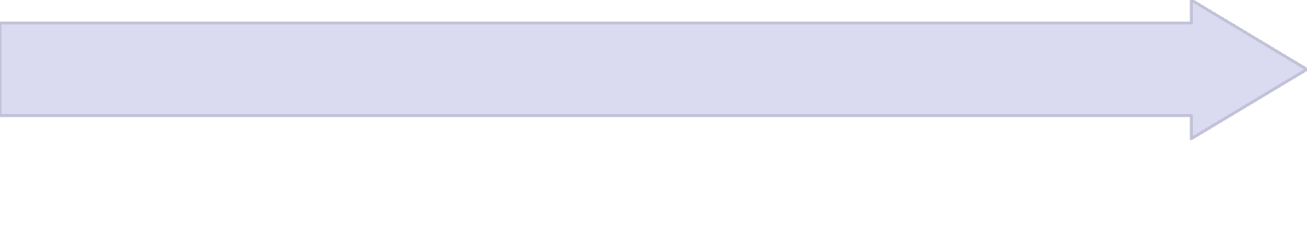

AWS Bedrock Nova Setup
API Key Generation
Console Access
Create 30-day key for authentication
Sign in with IAM permissions, navigate to Bedrock
Configuration
AMI Integration
Use IAM credentials in API headers
Launch EC2 instance, install AWS CLI
Best Practices: Temporary keys, regional verification, least-privilege principles for secure multimodal AI deployments.

Slide 53




NGINX Testing Framework
Test::Nginx
jirutka/nginx-testing
Performance Benchmarks
Perl-based configuration validation and behaviour verification
TypeScript/JavaScript acceptance tests for NJS modules
RPS/CPS measurements under HTTP/HTTPS loads
78%
Incident Reduction
Through comprehensive testing strategies
Counterviews stress real-world simulations to avoid over-optimization biases.

Slide 54



FastAPI Async Database Testing
Testing Approach
Key Features
Automatic validation
TestClient
High-performance concurrency
Built-in async function invocation
SQLAlchemy/asyncpg support
Best practice: Clear separation of sync/async code prevents runtime issues.
Pytest Integration
Dockerised Postgres for TDD
Fixtures & Overrides
Resolve integration challenges

Slide 55
LangChain Evaluation
LangSmith Core
Automated Chains
Open-Source Breakthroughs
Datasets, metrics, and tracking for LLM applications
Custom metrics with production monitoring
Agent testing frameworks, Crew AI compatibility
Debates focus on balancing automated and manual evaluations for comprehensive QA.

Slide 56



LangGraph Evaluation
Stateful Agent Testing
Security Scanning
Specialised Inspectors
LangSmith integration for node tracing and graph-specific mechanics
Promptfoo and Arize enable red-teaming via LLM judges
Verify robustness with open-source eval integrations
Challenges: Multi-agent complexities addressed through iterative debugging and performance analysis.

Slide 57
MCP Debug Framework
Model Context Protocol
Enterprise Tools
Facilitates AI model interactions with debugging via MCP Inspector—a React-based UI.
MCPJam: Enterprise evaluations
Playwright: UI/UX debugging
Server Testing
GitHub Copilot: Integration support
Interactive resource management
Platform-specific considerations (e.g., macOS); emerging standard in AI protocols.
Security Checks
Endpoint validation and compliance
Log Collection
Comprehensive debugging insights

Slide 58





General AI Agent Evaluation
6-Point Framework
1
Precision and scalability lessons
Enterprise Tools
2
Google Vertex, Kore.ai, IBM frameworks
Open-Source Options
3
Conversational testers, novel approaches
Core Metrics
4
Intent detection, bias prevention, compliance
Performance & Decision-Making
5
Task execution, behaviour visibility via Arize
Comprehensive evaluation encompasses performance, decision-making, and compliance across diverse AI agent architectures.

Slide 59
Framework Comparison
Technology
Primary Tool
Key Features
Use Cases
Limitations
LangSmith
LangSmith
Tracing, alerting, qualitative metrics
LLM debugging, monitoring
LLM-focused; vendor lock-in
AI Agent UI
LangWatch / DeepEval
Simulated users, regression tests
UI interaction testing
Automated bias; needs human oversight
AWS Bedrock
IAM API Keys
Key generation, regional access
Secure model inference
Misconfiguration risks
NGINX
Test::Nginx
Config testing, RPS/CPS benchmarks
Web server validation
NGINX-specific; over-optimization debates
FastAPI
Pytest + TestClient
Async testing, Docker integration
API/DB concurrency
Sync/async mixing issues
LangChain
LangSmith Evals
Datasets, custom metrics, tracking
LLM chain assessments
Automated vs. manual balance
LangGraph
LangSmith + Promptfoo
Graph evals, red-teaming, LLM judges
Stateful agent testing
Multi-agent challenges
MCP Debug
MCP Inspector
Interactive UI, security tests, logs
Protocol debugging
Platform-specific; emerging
AI Agent
Arize / Vertex AI
Behaviour visibility, 6-point framework
Task execution, bias prevention
No one-size-fits-all
Key Insight: Diverse frameworks require domain-specific expertise, with LangSmith excelling in LLM ecosystems whilst hybrid setups demand custom integrations.

